Slide 1

Department of Electronics & Communication Engineering
Home Automation with Load Scheduling Using IOT
PRESENTED BY,
Name: Hari Krishnan D
Madhan S
Deivanayagam S
Programme : ECE department
Roll No: 727621bec013
727621bec025
727621bec073
GUIDED BY :Dr.B.Kannapiran,professor/ECE

Slide 2
Contents
An measure the amount of energy consumed by domestic, commercial and industrial user, energy meter is being used.
In this work,the system uses in microcontroller with inbuild WIFI facility because it is energy efficient hence it consumes less power.
All the data monitoring is done via a web based portal provided with a dedicated internet connection.
The rapid advancement of technology has led to the development of the Internet od thinks(IOT).One of the application of IOT technology in controlling load and energy

Slide 3
Objectives
Energy Conservation: By controlling the energy usage of various devices and appliances in a application in a smart way,it becomes possible to conserve Energy and reduce electricity bills.
Demand-side Management: By monitoring and controlling the load in a smart way it becomes possible to balance the supply and demand of energy leading to more efficient energy usage.
Predictive Maintenance:IOT- enabled load controlling devices can provide insights into health of appliances and predict when maintenance is needed, leading to better maintenance practices and fewer breakdowns
Notes:
e

Slide 4
Block diagram
hLCD
Display
Mobile device
230 volt
Node mcu
Esp-8266
Wifi module
Current sensors
230V AC to 5V DC power supply module
relay
kLoad

Slide 5
Work plan
Week Tasks | Week1 (23/01/23) | Week2 (30/01/ 23) | Week3 (06/02/ 23) | Week4 (20/03/23) | Week5 (27/03/23) | Week6 (03/04/23)
Topic Discussion | Discuss about the basis | Confirm the title
Confirmation of Tittle |  | Studied about IOT
Paper Identification |  |  | Read about load | Read about controller
Problems identificatio |  |  |  |  | Novelty in area | Novelty confirmation

Slide 6
Work Completed for First review (Present the tasks completed in the work plan)
Week Tasks | Week1 (23/01/23) | Week2 (30/01/23) | Week3 (06/02/23) | Week4 (13/02/23) | Status
Topic Discussion | Discuss about the basics | Confirm the tittle |  |  | Completed
Confirmation of Tittle |  | Studied about Iot | circuit verification |  | Completed
Problem identification |  |  | Circuit diagram stimulation | Circuit diagram stimulation | Completed

Slide 7
Work Completed for Second review (Explain the completed tasks)
Week Tasks | Week1 (20/03/23) | Week2 (27/03/23) | Week3 (03/04/23) | Week4 (10/04/23) | Status
Circuit connection | Components discussion |  |  |  | Completed
Circuit diagram overview |  | Details about the components |  |  | Completed
Current sensors |  |  | Studied about current sensors |  | Completed
Circuit diagram |  |  |  | connection | In-progress

Slide 8
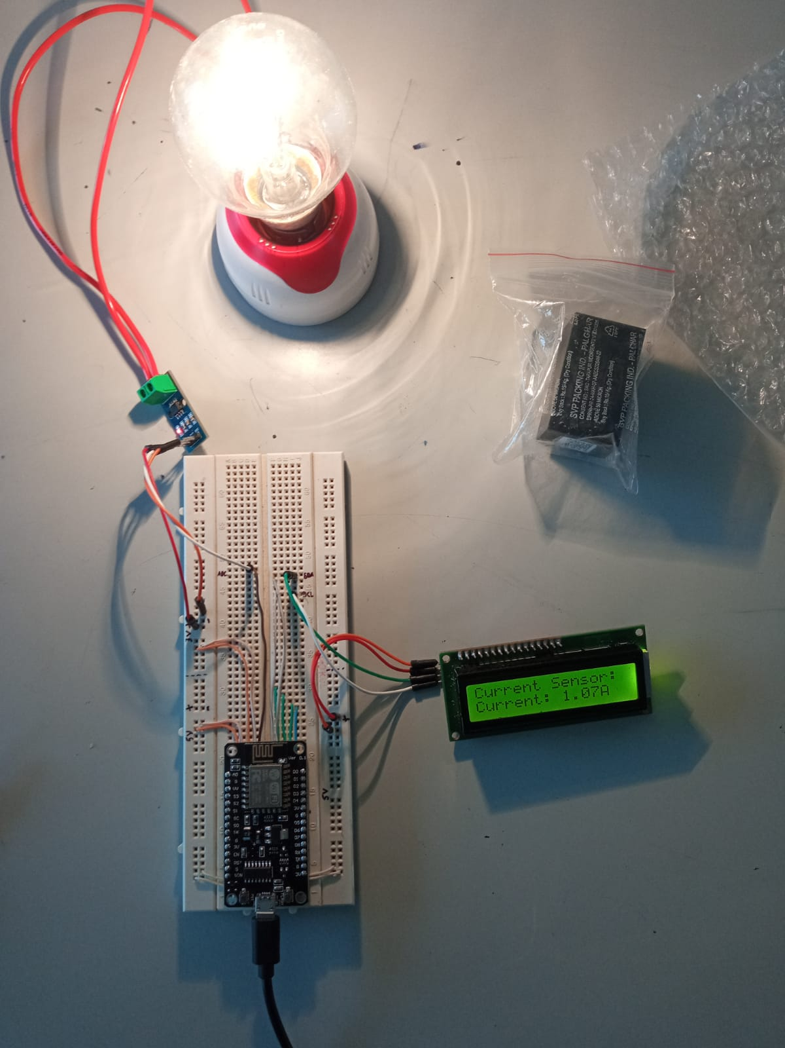
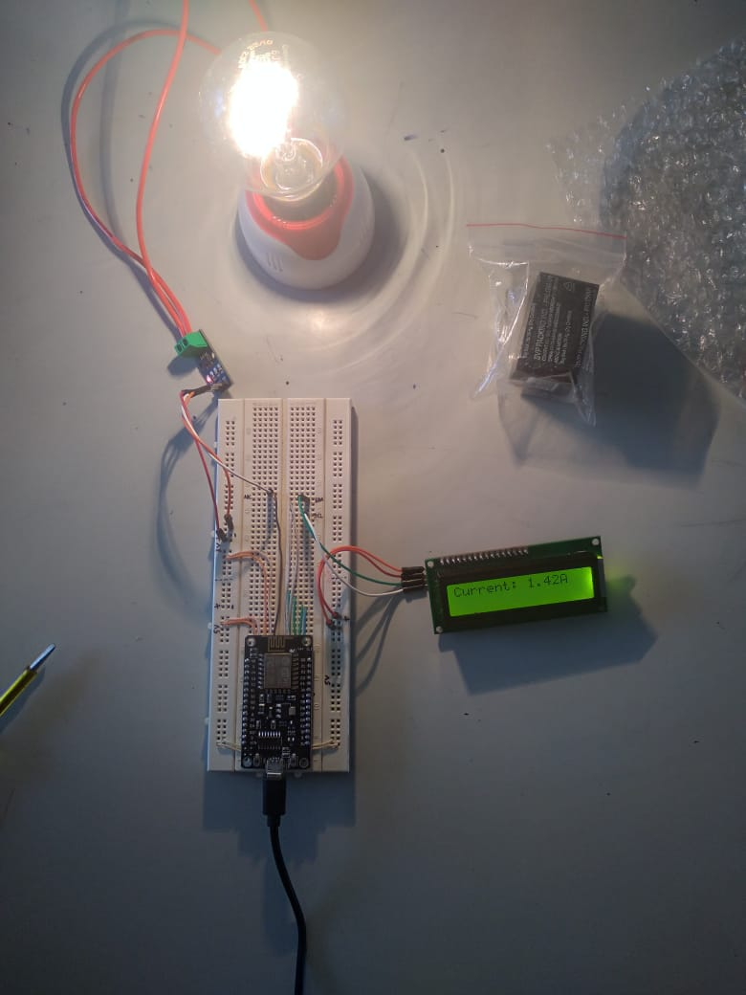
Results (Present the results of Completed tasks)

Slide 9
Inference or Conclusion
The final output of this project is to monitor the
Current given to the load and to scheduling using iot.
This project identifies the disadvantages in load scheduling and produces a better ideas.

Slide 10
References
Frederik vom Scheidt, Philipp Staudt, Christ of Weinhardt, "Assessing the Economics of Residential Electrity Traiff Selection", 2019 International Conference on Smart Energy Systems and Technologies, vol. 2, pp. 1-6, September, (2019).
Hamed Mortaji, Siew Hock Ow, MahmoudMoghavvemi, and Haider Abbas F. Almurib, "LoadShedding and Smart-Direct Load Control Using Internetof Things in Smart Grid Demand ResponseManagement", IEEE Transactions on IndustryApplications., vol. 53, Issue: 6, Nov, (2017).
Qusay F.Hassan, Internet of Things A to Z: Technologies and Applications, Nigeria, John Wiley- IEEE Press, 1st edition, (2018).

